Slide 1
8086 Memory Segmentation
The Intel Microprocessors 8th Edition
by Brey
>2–2 REAL MODE MEMORY ADDRESSING
Segments and offset
Assembly language programming Ytha Yu
> Chapter 3 section 3.2
Md. Shafqat Talukder Rakin
Lecturer, Department of CSE,
United International University
Email id : shafqat@cse.uiu.ac.bd
Courtesy: Nasif M. Sir

Slide 2
Memory Segmentation
- The total memory size is divided into
segments of various sizes.
- A segment is just an area in memory.
- The process of dividing memory this way is called Segmentation.

Slide 3
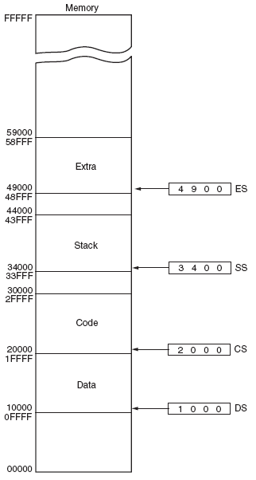
Figure : The 8086 memory segments.

Slide 4
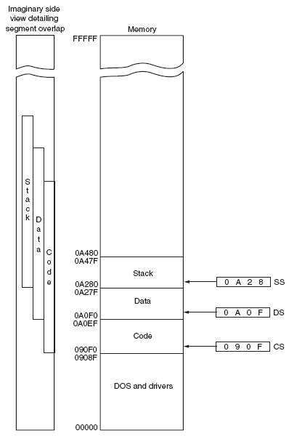
Figure : Overlapping of the 8086 memory segments.

Slide 5
Segmentation and offset
Book chapter: Ytha yu 3.2.3 Segment Registers
Memory Segment
A memory segment is a block of 64 KB memory blocks. Each segment is identified by a segment number, starting with 0000H. A segment number is 16 bits, so the highest segment number is FFFFH.
Within a segment, a memory location is specified by an offset. This is the number of bytes from the beginning of the segment. The first byte in a segment has offset 0. The last offset in a segment is FFFFH.
Segment: Offset Address
A memory location may be specified by providing a segment number and an offset, written in the form segment: offset; this is known as a logical address. For example, A4FB:4872h means offset 4872H within segment A4FBH.

Slide 6
Segmentation and offset
Segmentation is used to increase the execution speed of computer system so that processor can able to fetch and execute the data from memory easily and quickly.
The size of address bus of 8086 is 20 and is able to
address 1 Mbytes of physical memory.
The compete 1 Mbytes memory can be divided into 16 segments, each of 64 Kbytes size.

Slide 7
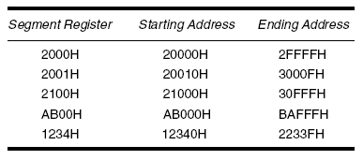
Once the beginning address is known, the ending address is found by adding FFFFH (64K).
For example, if a segment register contains 3000H, the first address of the segment is 30000H, and the last address is 3FFFFH.
The following table shows several examples of segment register contents and the starting and ending addresses of the memory segments selected by each segment address.

Slide 8
A segment starts at a particular address and its maximum size can go up to 64 Kbytes. But if another segment starts along this 64Kbytes location of the first segment, the two segments are said to be overlapping segment.

Slide 9
Memory Segmentation
In 8086, memory has four different types
of segments.
These are:
-Code Segment
-Data Segment
-Stack Segment
-Extra Segment

Slide 10
Segment Registers
- Each of these segments are addressed by an address stored in corresponding segment register.
- These registers are 16-bit in size.
- Each register stores the base address (starting address) of the corresponding segment.
- Because the segment registers cannot store 20 bits, they only store the upper 16 bits.

Slide 11
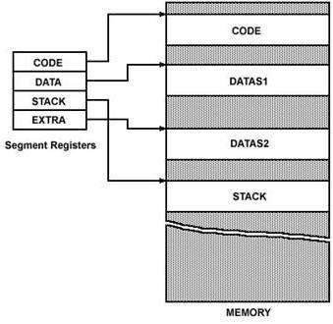

Slide 12
Segment Registers
Q: How is a 20-bit address obtained if there are only 16-bit registers?
The 20-bit address is called Physical Address.
The 16-bit address is called Logical Address.
Logical address is in the form of:
Base Address : Offset
Offset is the displacement of the memory location
from the starting location of the segment.
Thus a memory location may be specified by providing the 16-bit segment base address, and a 16-bit offset, written in the form
segment : offset; this is known as a logical address for the memory location.

Slide 13
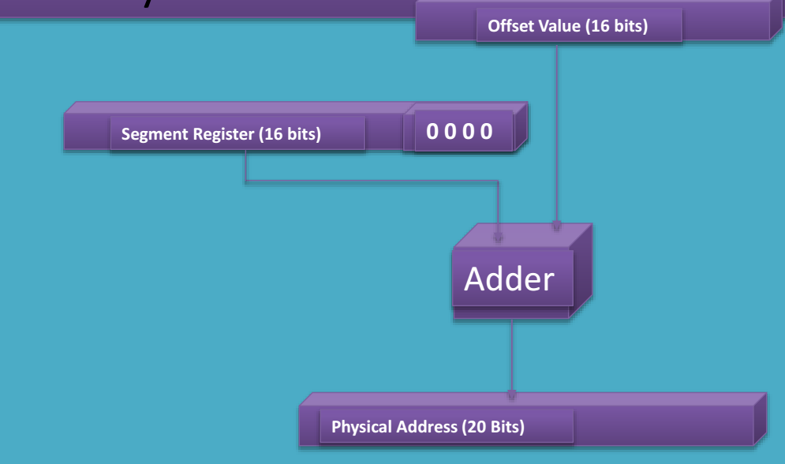

Slide 14
Segment Registers
For example, the logical address A4FBH : 4872H means offset 4872H within segment A4FBH, that is, the segment starting at physical address A4FB0H.
To obtain the corresponding 20-bit physical (i.e., absolute) address, the 8086 microprocessor first shifts the segment base address 4 bits to the left (this is equivalent to multiplying by 10H), and then adds the offset. Thus the physical address for A4FB:4872h is:
A4FB0h
+ 4872h
A9822h (20-bit physical address)

Slide 15
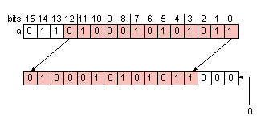
Left shift 3 bit
Bits positions vacated by shift are filled with zeros

Slide 16
Example
If the data at any location has a logical
address specified as: CS: IP
2222 H : 0016 H
Then, 2222 H is the value of Base address. The number 0016 H is the offset . Calculate the physical address?

Slide 17
Example
The value of Code Segment Register (CS) is 2222 H
Convert this 16-bit address into 20-bit,
The starting address of the Code Segment becomes 22220H

Slide 18
Example (Contd.)
Therefore:
2222 * 10 H
+ 0016 H
------------
22236 H
Physical address =

Slide 19
Example (Contd.)
2222 H
offset = 0016 H | BYTE – 0
 | BYTE – 1
 | BYTE – 2
 | - - - - -
 | Addressed Byte
22220 H
CS Register
22236 H

Slide 20
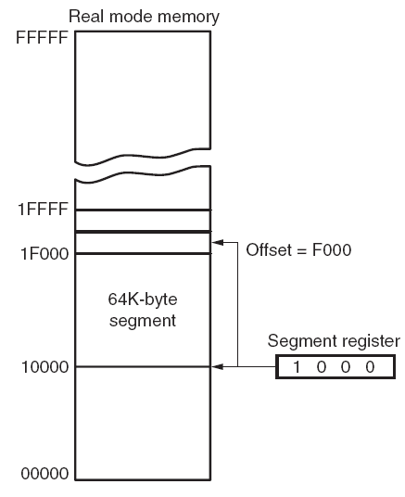
Figure : The 8086 memory-addressing, using a segment address plus an offset.

Slide 21
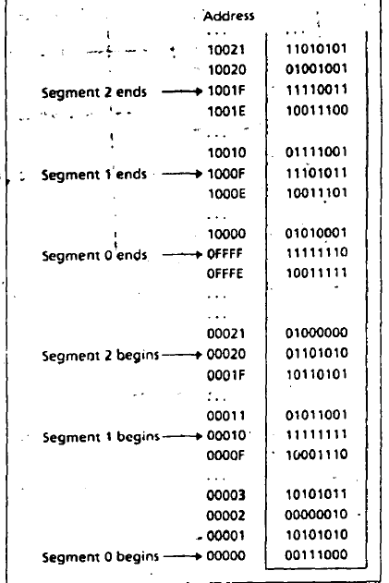
Segment: Offset Address (Logical Address)
To obtain a 20 bit physical address,
- Shift the segment address 4 bit to the left ( i.e. multiply by 10h)
- Add the offset
Example:
Segment : offset = A4FB:4872h
Physical address
= segment number * 10h + offset
= A4FBh * 10h + 4872h = A9822h
Segments may overlap, so the segment : offset form of an address is not unique.

Slide 22
Default Segment and Offset Registers
The 8086 has a set of rules that apply to segments whenever memory is addressed. These rules, define the segment register and offset register combination. For example, the code segment register (CS) is always used with the instruction pointer (IP) to address the next instruction in a program.
The code segment register defines the start of the code segment and the instruction pointer locates the next instruction within the code segment.
This combination (CS:IP) locates the next instruction executed by the CPU.
For example, if CS=1400H and IP=1200H , the microprocessor fetches its next instruction from memory location or 15200H.

Slide 23
Default Segment and Offset Registers
Another default combinations is the stack.
Stack data are referenced through the stack segment register (SS) at the memory location addressed by either the stack pointer (SP) or the pointer (BP).
These combinations are referred to as SS:SP or SS:BP. For example, SS=2000H and BP=3000H , the CPU addresses memory location 23000H for the stack segment memory location. Other defaults of segment and offset combinations are shown in the following table.

Slide 24
Where to Look for the Offset
Segment | Offset Registers | Function
CS | IP | Address of the next instruction
DS | BX, DI, SI | Address of data
SS | SP, BP | Address in the stack
ES | BX, DI, SI | Address of destination data (for string operations)

Slide 25
Question
The contents of the following registers are:
· CS = 1111 H
· DS = 3333 H
· SS = 2526 H
· IP = 1232 H
· SP = 1100 H
· DI = 0020 H
Calculate the corresponding physical addresses for the address bytes in CS, DS and SS.

Slide 26
Solution
1. CS = 1111 H
The base address of the code segment is 11110 H.
Physical address of memory is given by 11110H + 1232H = 12342H.
2. DS = 3333 H
The base address of the data segment is 33330 H.
Physical address of memory is given by 33330H + 0020H = 33350H.
3. SS = 2526 H
The base address of the stack segment is 25260 H.
Physical address of memory is given by 25260H + 1100H = 26360H.

Slide 27
Because segments may overlap, the segment : offset form of an address is not unique for a particular memory location as is the case for the physical address of that memory location.
Example 3.1 For the memory location whose physical address is specified by 1256Ah, give the address in segment : offset for segments 1256h and 1240h

Slide 28
Example 3.1 For the memory location whose physical address is specified by 1256Ah, give the address in segment : offset for segments 1256h and 1240h
Solution:
Physical address = segment number * 10h + offset
=> 1256AH = 1256h * 10H + offset
=> Offset = 1256AH – 12560H = AH
So, 1256AH = 1256 H : 000AH
Physical address = segment number * 10h + offset
=> 1256AH = 1240H * 10H + offset
=> Offset = 1256AH – 12400H = 16AH
So, 1256AH = 1240 H : 016AH

Slide 29
Segment: Offset Address (Logical Address)
Example 3.2 A memory location has physical address 805D2h. In what segment does it have offset BFD2h?

Slide 30
Segment: Offset Address (Logical Address)
Example 3.2 A memory location has physical address 805D2h. In what segment does it have offset BFD2h?
Solution:
Physical address = segment number * 10h + offset
=> 805D2h = segment number * 10h + BFD2h
Segment number = (805D2h – BFD2h)/10h = 74600h/10h = 7460h
So, 805D2h = 7460 h : BFD2h

Slide 31
Thank you

